Slide 1

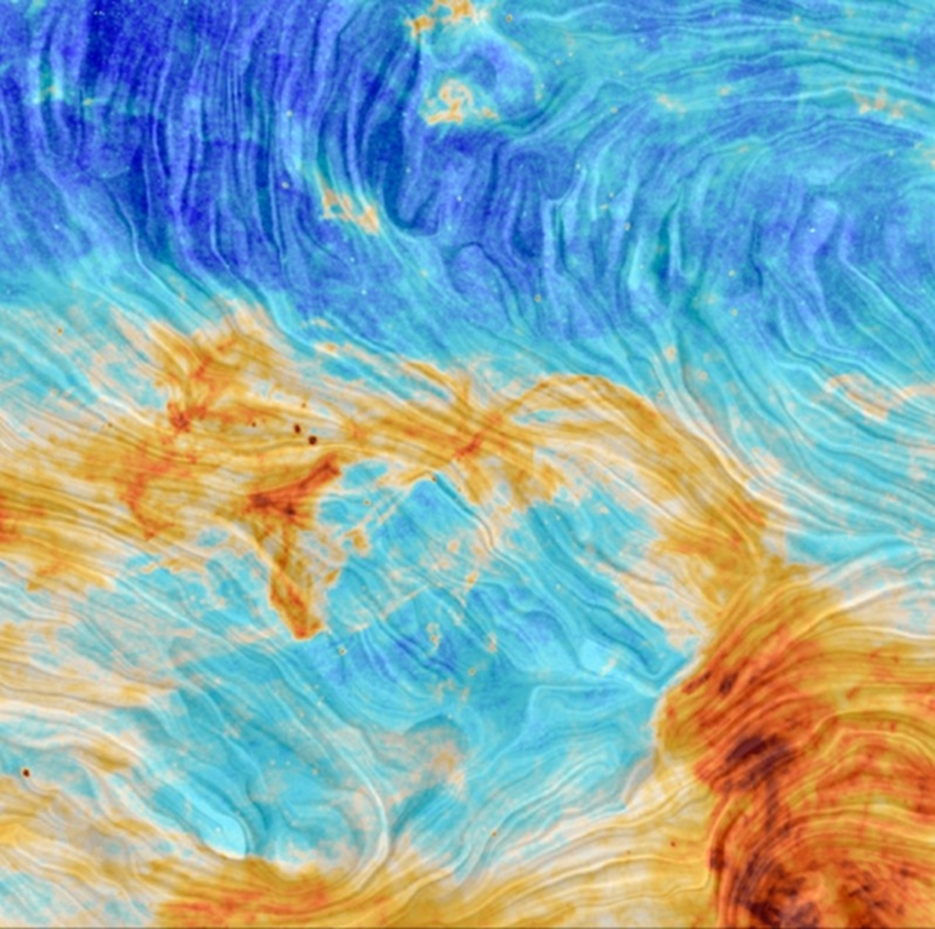
Spectral Analysis of the SPIDER region using ROHSA
Mukesh Taank (mtaank)
Supervisors: Peter G. Martin and Antoine Marchal
July 9, 2020

Slide 2
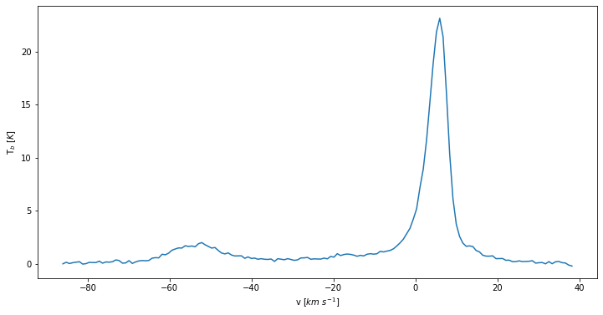
Looking along a single line of sight
Observation along the 21 cm line for one line of sight
Along one line of sight, we can extract a single spectrum to represent the emission.
In this spectrum (left), there are interesting features at around 0 km/s and -50 km/s. These can be modeled using Gaussians.
We observe both warm and cold gases from these spectra.
Narrow features indicate cold gas
Broader features indicate warm gas
Spectrum along one line of sight on the Spider from the data cube.

Slide 3
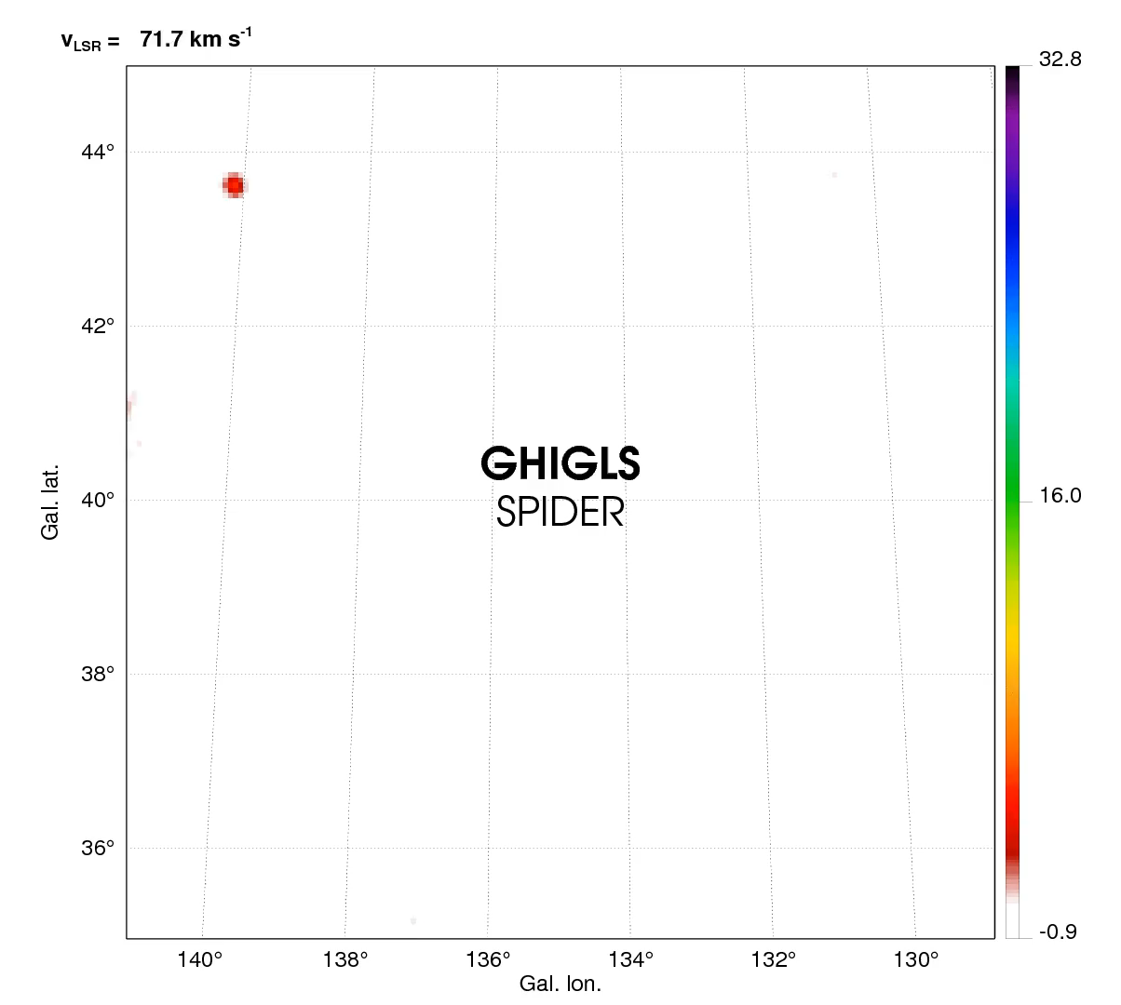
Visualizing the Data Cube
I am using the HI spectral data from the Green Bank Telescope (GHIGLS).
The data are stored in a PPV data cube (Position-Position-Velocity).
The features seen are interstellar structures of Hydrogen (HI).
The video shows the brightness temperature [K] over each velocity channel.

Slide 4
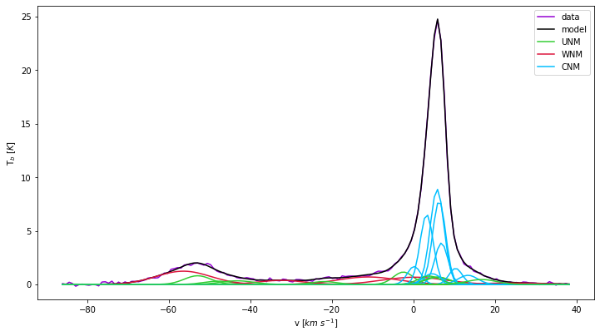
ROHSA (Regularized Optimization for Hyper-Spectral Analysis)
We are analyzing Doppler shifts and broadening, looking at the Gaussian features in the data with ROHSA.
ROHSA is a code for decomposing the data seen in the movie, with Gaussian functions.
ROHSA uses hyper parameters which control the smoothness of the solution.
Data
Model
CNM
UNM
WNM
Spectrum of the bright pixel on the Spider with ROHSA’s multi - Gaussian decomposition
https://www.youtube.com/watch?v=wzhnF66ZomE

Slide 5
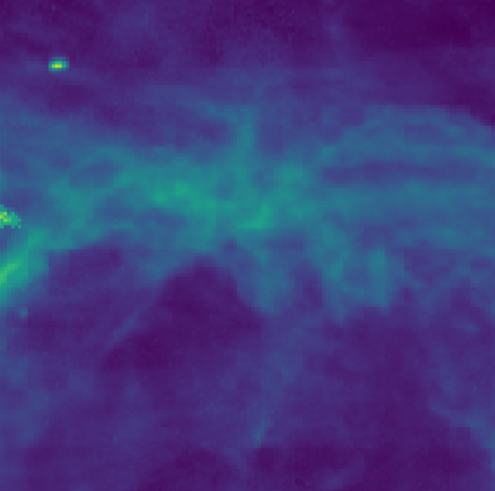

Generating a map of Column Density
This is the spiral galaxy IC 2574, part of the M 81 group of galaxies.
Column density is the sum of the brightness temperature over the velocity range:
$N_{HI}=C\int_{−∞}^{∞}{T_{b}(v) dv}$[cm⁻²]
From these maps, we can more easily analyze the features that make up the Spider.
An interesting feature is the little point source in the top left corner.
Column Density Map of the Spider

Slide 6
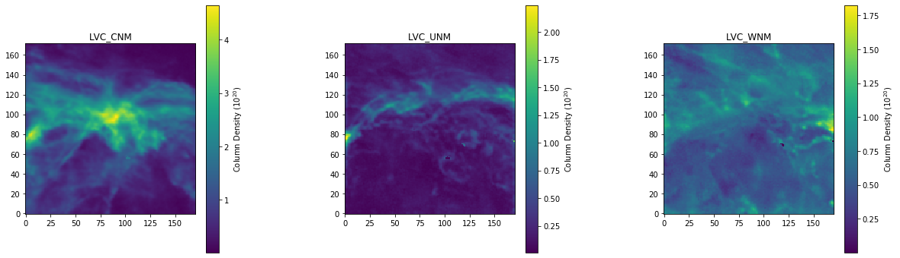
Looking at the Gas
From ROHSA’s decomposition, I am able to sort the Gaussians by their velocity dispersion, to identify cold and warm regions, which gives a 3-phase model of the Spider.
Units for these figures: HI Column Density (10²⁰ cm⁻²)
Column Density Maps of the 3-phase models of the Spider (cold, unstable and warm)

Slide 7
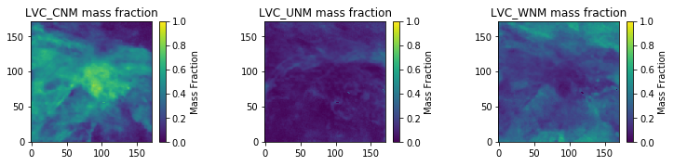
Looking at the Gas (cont.)
I can look at the mass fraction of the phases. Almost 80% of the actual Spider is made up of cold gas (CNM), whereas it contains ~10% of warm gas (WNM).
The gas has undergone a phase transition from warm gas to cold gas in the Spider.
Maps of the mass fraction for each of the phase models along every line of sight

Slide 8
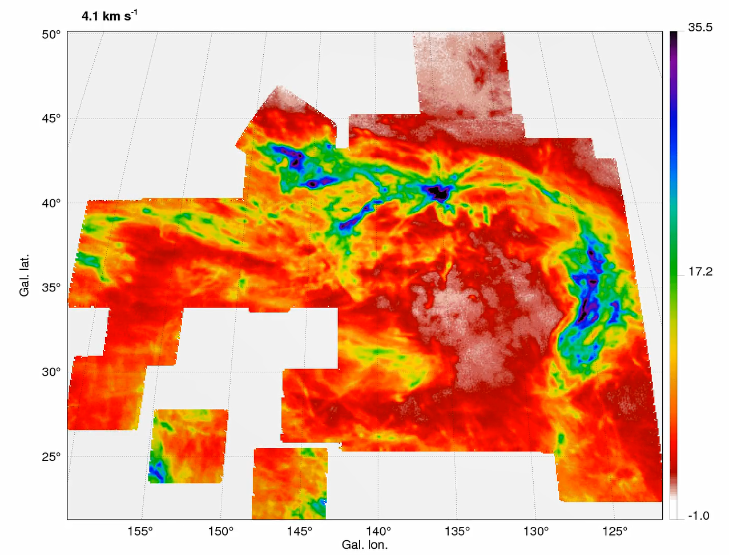
Next Steps…
So far, I have been looking at a small area of the Spider, but from the North Celestial Pole Loop (seen right), there is a lot more to the Spider.
It extends out much further and has many new unique features to be analyzed.

Slide 9
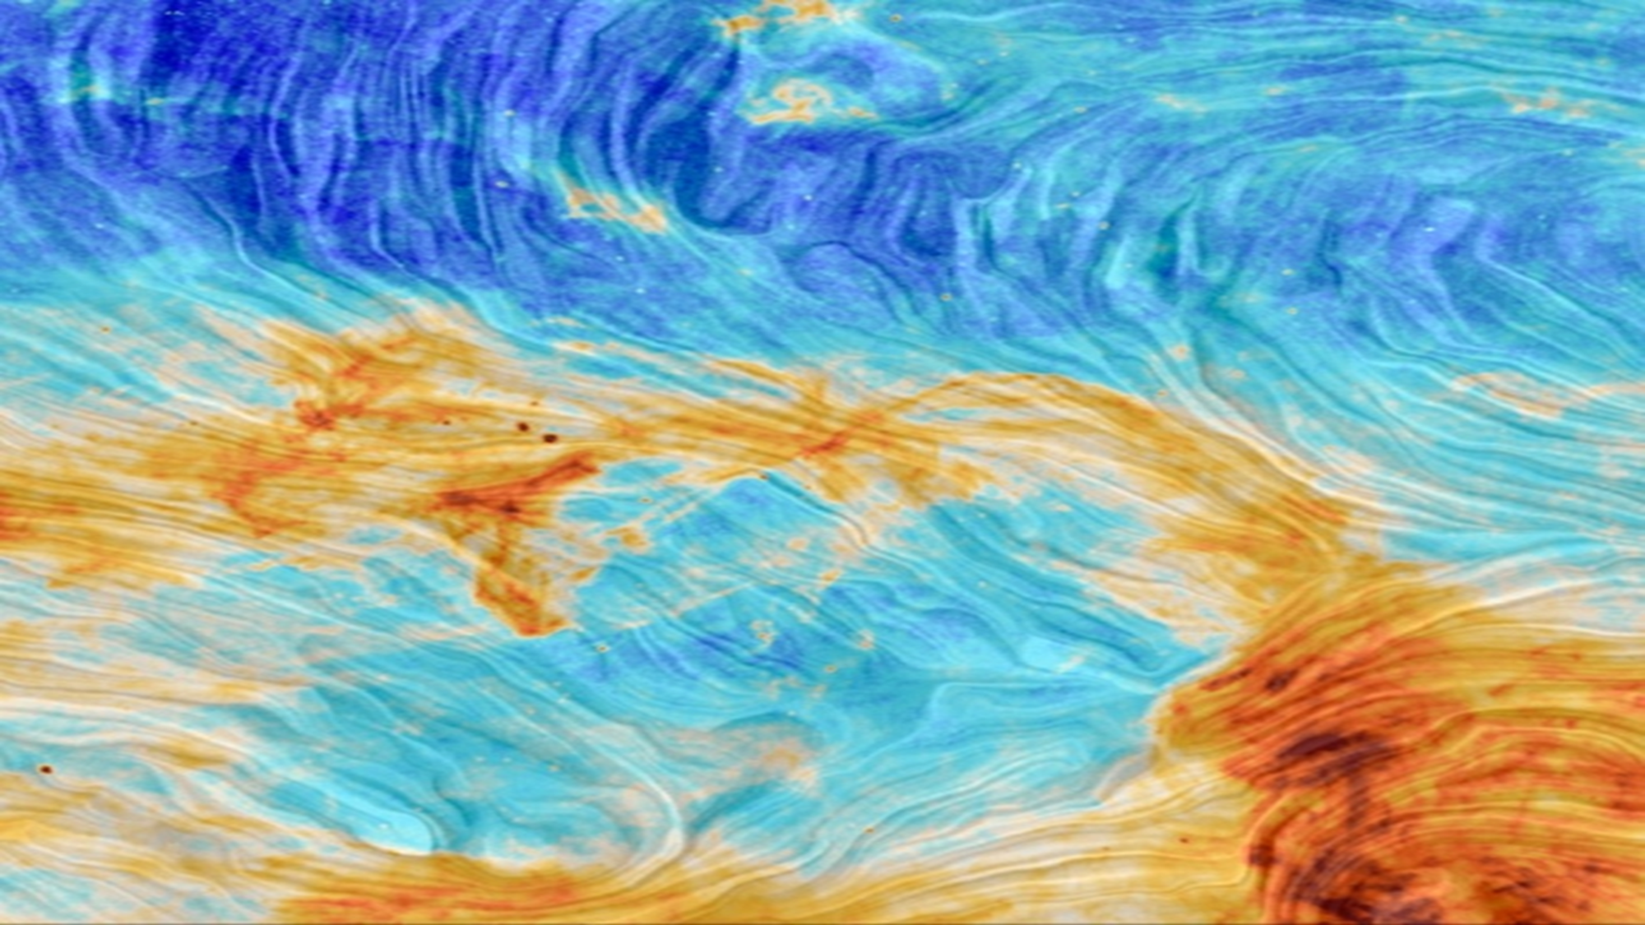
THANK YOU! Questions?

